Slide 1

Turf-Kick: A turf booking platform
Presented by:
MCA041: Navaneeth Krishna MCA042: Neeraj N
MCA043: Nehmal N MCA044: Nidhish Chandran

Slide 2

Introduction
Manual turf booking is time- consuming and inconvenient.
Turf-Kick allows users to search
and book turfs online.
Provides real-time slot availability and equipment booking

Slide 3
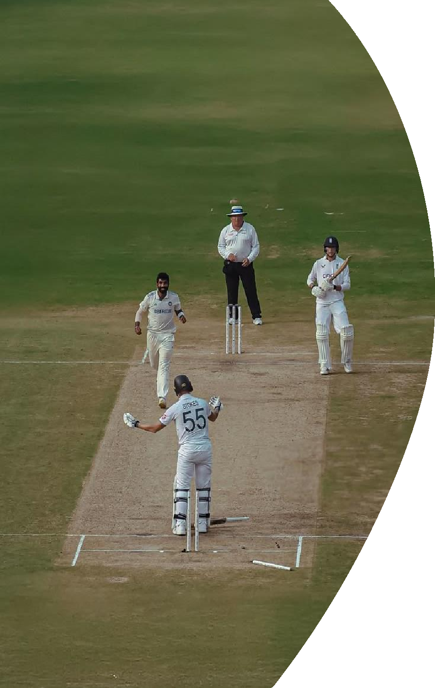
PROJECT OVERVIEW
CURRENT CHALLENGES
Sports infrastructure suffers from inefficient management with manual booking methods causing time conflicts and poor facility utilization.
PLATFORM SOLUTION
Web-based system simplifying turf booking and sports accessory rental through online platform.
KEY FEATURES
Real-time availability, instant reservations, equipment rental, secure authentication.

Slide 4
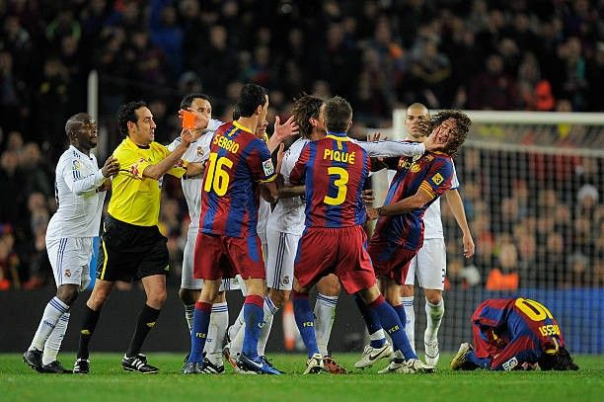
PROBLEM STATEMENT
Manual Booking Bookings are done via phone calls or in person.
Double Booking
Issues
Manual Record Keeping
No Real-Time Availability Users cannot check turf availability before booking.
No Unified Platform No single system to manages turfs and sports accessories together.

Slide 5
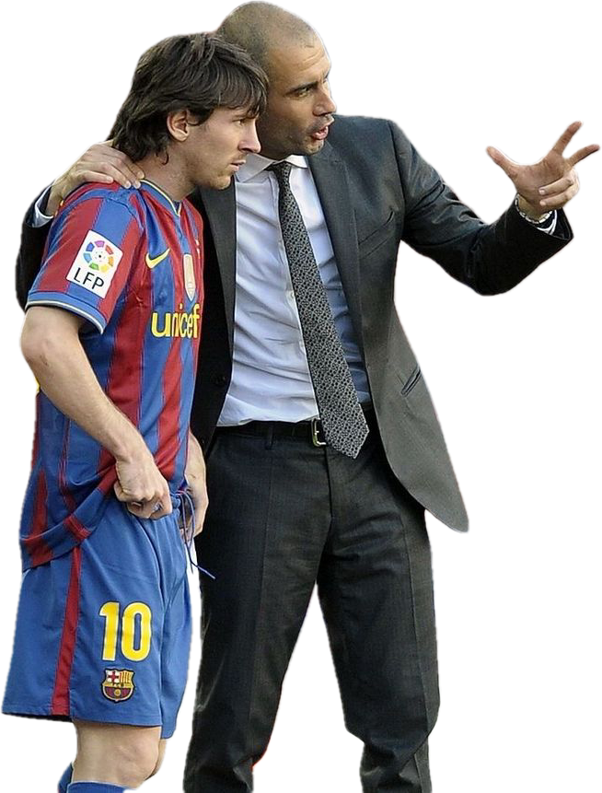
OBJECTIVES
Online Turf Booking Platform Develop a web platform to book sports turfs online.
Easy Turf Search Users can search turfs and view available time slots.
Secure User Login Provide authentication for safe account access.
Accessory Booking Allow booking of sports accessories with turf.
Prevent Double Bookings Use automated updates to manage availability.

Slide 6

Existing System Vs Proposed system
Features | Existing system (Manual) | Turf-kick
Booking method | Manual booking through phone calls or in person | Online booking through web platform
Availability Check | Users cannot check real-time turf availability | Real-time availability of turfs is displayed
Booking Conflicts | High chance of double booking | System prevents duplicate bookings
Booking Management | Managed manually using registers | Automated booking management system
Access to Accessories | No integrated option for sports accessories | Users can add accessories during booking
User Convenience | Time-consuming and less efficient | Fast, easy, and accessible from anywhere
Record Maintenance | Manual records prone to errors | Digital database for accurate records

Slide 7

Technology Stack
Frontend
Backend
Tools Used
HTML
CSS
JavaScript
PHP
MySQL
Vs Code
Git & GitHub
Xampp

Slide 8
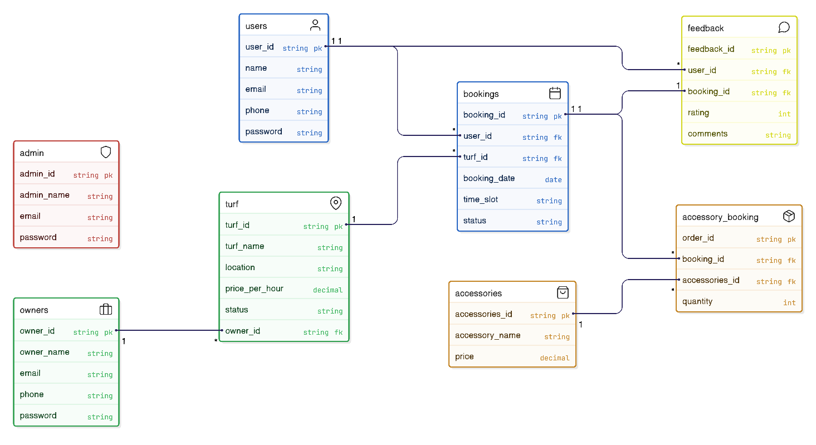
DATABASE DESIGN

Slide 9
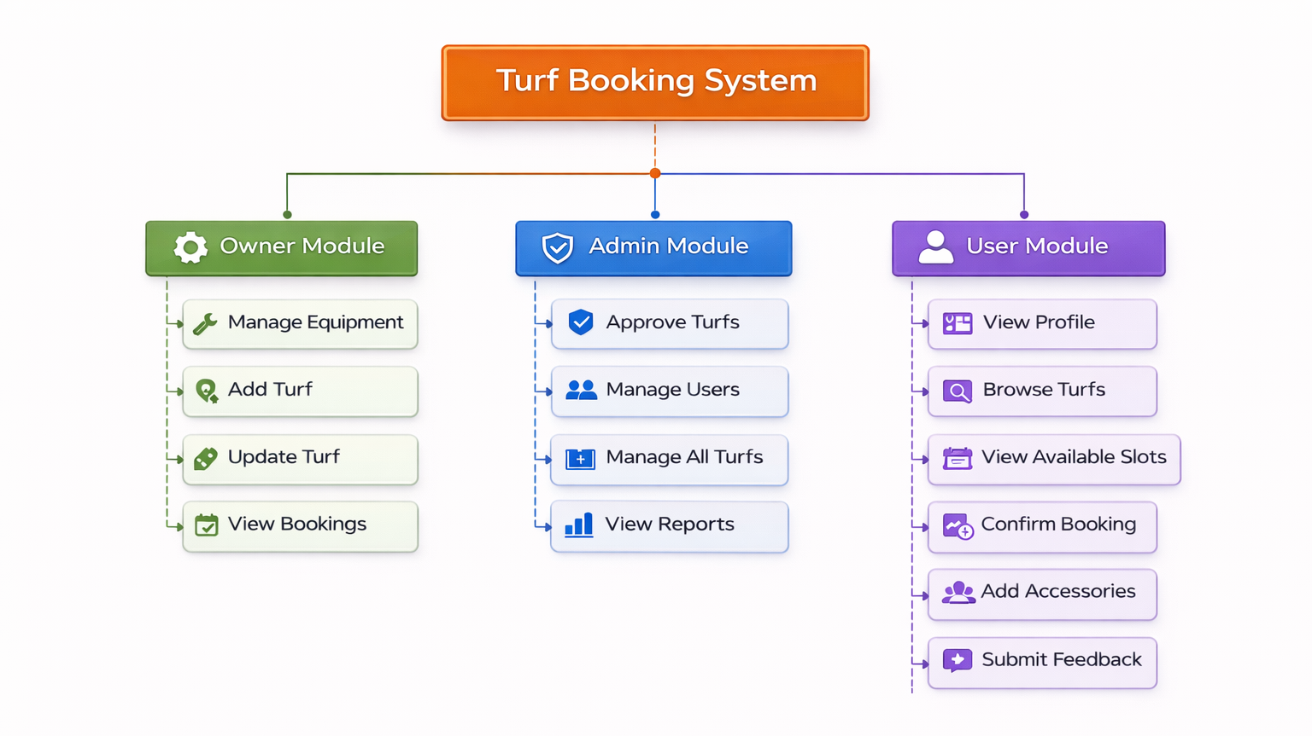
STRUCTURE CHART

Slide 10
MODULES
User Module
Allows users to create an account and log in securely.
Users can browse available turfs and check time slots.
Enables booking of turfs based on availability.
Users can add sports accessories during booking.
Allows users to view their profile and submit feedback.
Owner module
Turf owners can log in to manage their turfs.
Owners can add new turf details to the system.
Allows updating turf information and availability.
Owners can manage sports equipment and accessories.
Provides access to view booking details made by users.
Admin module
Admin manages and monitors the entire system.
Approves turfs added by owners before listing.
Admin can manage users and turf records.
Allows viewing and monitoring all bookings.

Slide 11
Challenges Faced
Database Design Complexity
Structuring tables and relationships for users, turfs, bookings, and accessories.
Preventing Double Bookings
Ensuring the same turf and time slot cannot be reserved multiple times.
User Authentication Issues
Implementing secure login and session management.
User Interface Design
Designing a simple, responsive, and user-friendly layout.
Real-Time Availability Updates
Updating booking slots immediately after reservations.
Managing Turf Availability Data
Organizing time slots and booking details efficiently.

Slide 12




Future Plan
Integrate Online Payment System | Develop Mobile-Friendly Interface | Add Notification System | Improve Security Features
Enable users to make secure payments during booking. | Improve responsiveness for better mobile user experience. | Send booking confirmations and reminders via email or SMS. | Implement stronger authentication and data protection methods.

Slide 13
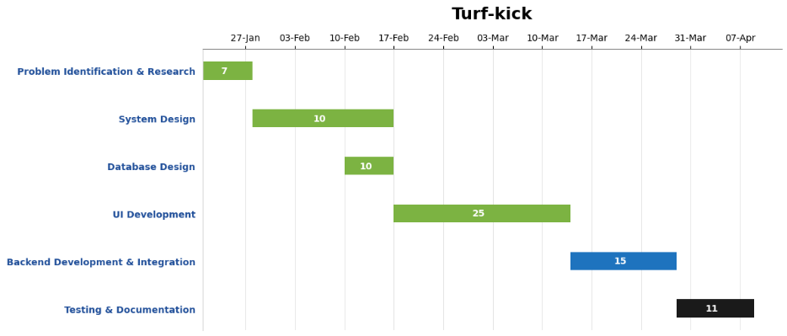
PROJECT TIMELINE
18
7
23
23
7

Slide 14
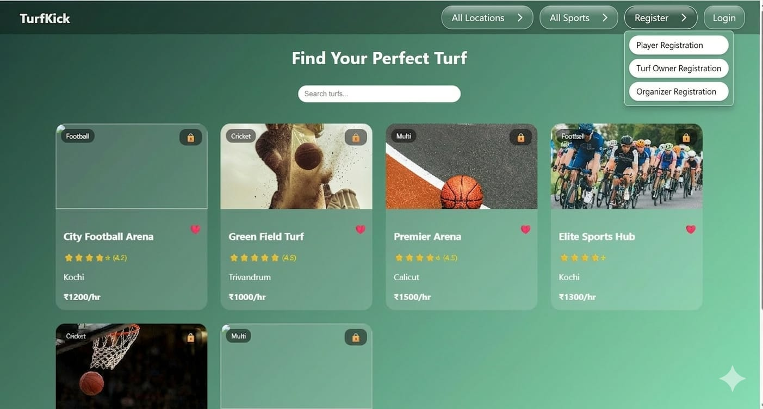
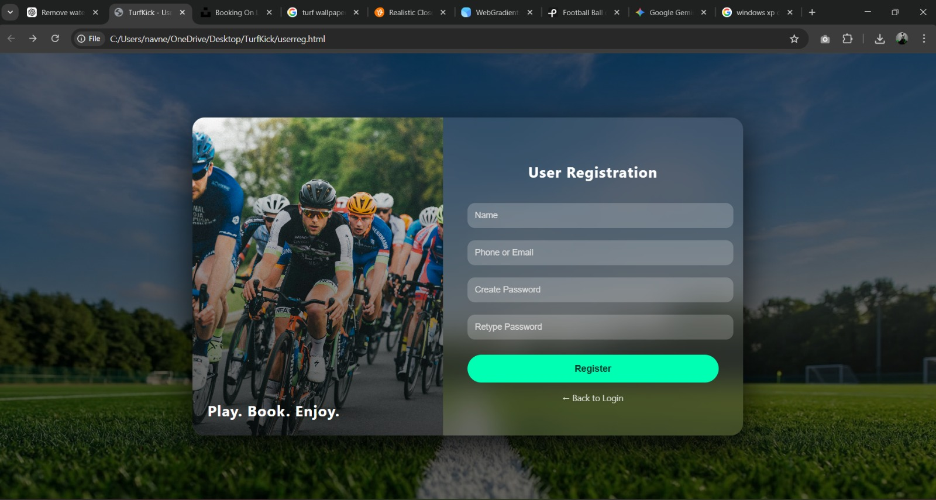
Index Page
FRONTEND DESIGN
User Registration

Slide 15
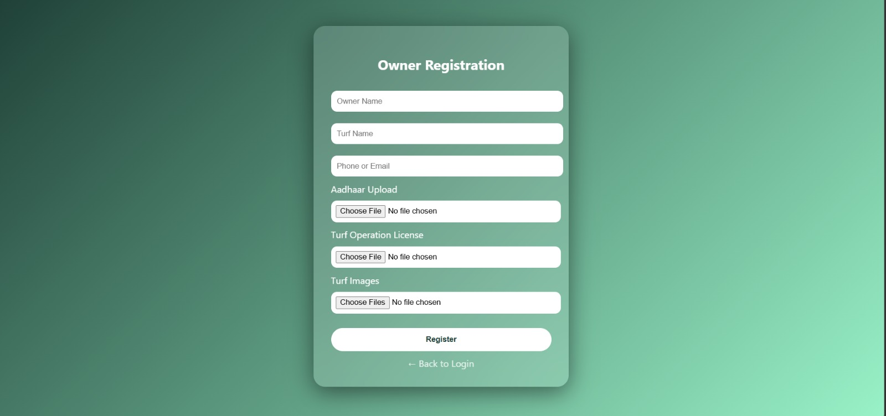
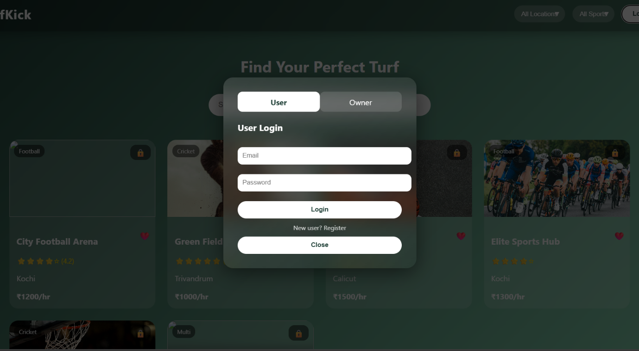
FRONTEND DESIGN
Owner Registration
Login Page

Slide 16


CONCLUSION
“Turf-Kick simplifies turf booking with real-time access and efficient management, with future plans to expand into a complete smart sports platform.”

Slide 17
CONCLUSION
Simple Turf Booking Platform Provides an easy web-based solution for turf reservations.
Real-Time Availability Users can quickly check available turfs and time slots.
Efficient Booking Management Reduces manual work and avoids scheduling conflicts.
Better User Experience Improves convenience for both players and turf owners.
Future Scope Can expand into a complete sports facility management system.

Slide 18


